Slide 1
Project Management Operations
MSPM1-GC2030
Session Number 2
Managing Project Scope

Slide 2

Agenda
Stakeholder Engagement
Project Scope Management
SMART Goals
Project Charter Exercise
Requirements
Case study discussion

Slide 3

Prepare
45 Minutes

Slide 4
PMBOK
Scope
Management

Slide 5

Topics
Leadership
Project Scope
Elements for Project Success
5

Slide 6
Integration of Processes and Tools
Processes
Tools
People
Communication
6

Slide 7
Scope Management
Who? What? Why?
MSPM1-G2030
  Today’s reading (Chapter 1):
  1. Military case study project:
  Describe the problem in the case.
  What went wrong with the solution?
  What is the root cause of the failure?

Slide 8
Scope Management
Who? What? Why?
MSPM1-G2030
  Today’s reading (Chapter 1):
  2. Port Authority Construction project:
  Describe the problem in the case.
  Why is the project complex?

Slide 9
Scope Management
Who? What? Why?
MSPM1-G2030
  Today’s reading (Chapter 1):
  3. Wireless Mobile Portability project:
  Describe the problem in the case.
  Why is the project complex?

Slide 10
Scope Management
Who? What? Why?
MSPM1-G2030
  Today’s reading (Chapter 1):
  Why are requirements important?
  How does scope impact budgeting?

Slide 11
Project Charter
A document sanctioning the existence of the project and authorizes the project manager to begin applying resources to project activities.
Usually, the project charter is issued by the project initiator or project sponsor… and NOT the project manager.

Slide 12
Project Scope Management
Project Scope Management involves ensuring all of the required work and only the required work necessary to complete the project is accomplished.

Slide 13
Establish the Project Objectives
  Vision / Accomplishments
  Benefits
  Deliverables
  Dates
  Resources
  Budget

Slide 14
Project Scope: The work that must be performed to deliver a product, service, or result with the specified features and functions.
Scope Management: the function of controlling a project in terms of its goals and objectives

Slide 15
Scope Management Plan
A project’s size, complexity, and importance, as well as other factors, affect how much effort is spent on scope planning
The main output of scope planning is a scope management plan
  Descriptions of how the team will prepare the scope statement
  Document the requirements (deliverables)
  Verify completion of the project deliverables
  Control requests for changes to the project scope

Slide 16
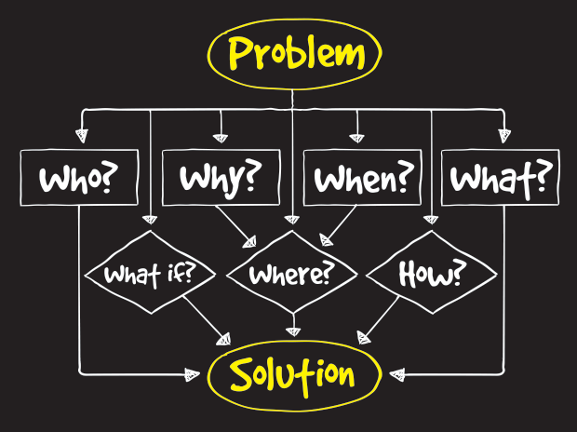
Anatomy of a Problem
Scope: Describe the rationale for the project

Slide 17
SMART
Goals
  Specific (Clearly defined)
  Measurable (Objective)
  Attainable (Achievable)
  Relevant/Realistic (Align mission)
  Time Sensitive (Deadline)
  Extending (Extra Risk adds value)
  Rewarding (‘Wow’ factor)

Slide 18
.
SMART
Goals
What are your near-term goals (1 year)
What are you somewhat longer goals (3 years)
Share one short term (1 year) SMART goal with the class.

Slide 19
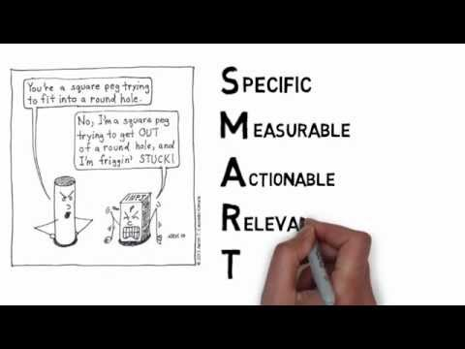
SMART
Goals

Slide 20
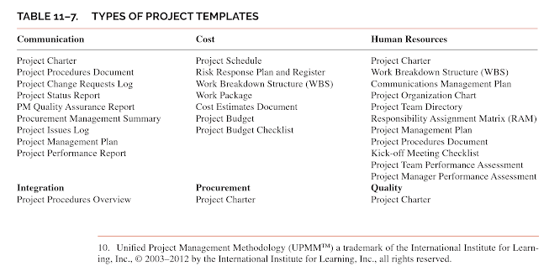
Types of Project Templates
Kerzner, p. 398-399 Chap 11
Source: https://play.google.com/books/reader?id=VNExDgAAQBAJ&printsec=frontcover&output=reader&hl=en&pg=GBS.PA398

Slide 21
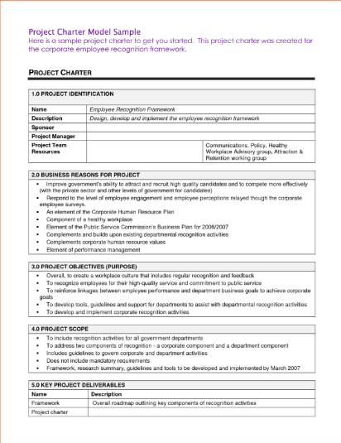
SMART
Goals
Source: https://www.thepersimmongroup.com/project-charter-template-2/

Slide 22
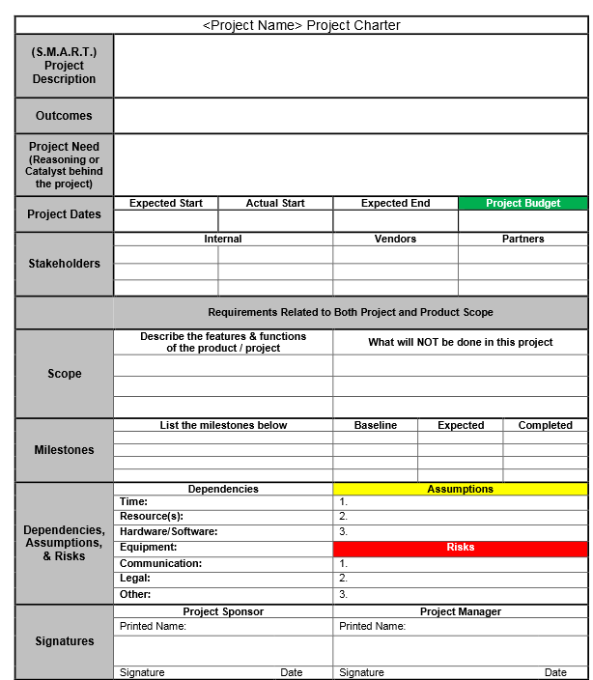
SMART
Goals
Source: http://www.sopexample.info/project-charter-template//
Notes:
Concepting: The process that addresses project objectives by finding the best ways to meet them.
Business and Project Objectives
Context Diagram Reflecting Business Processes Impacted and External Entities (Interfaces)
Project Constraints
Project Assumptions
Critical Success Factors
Proposed Product / Service Statement

Slide 23
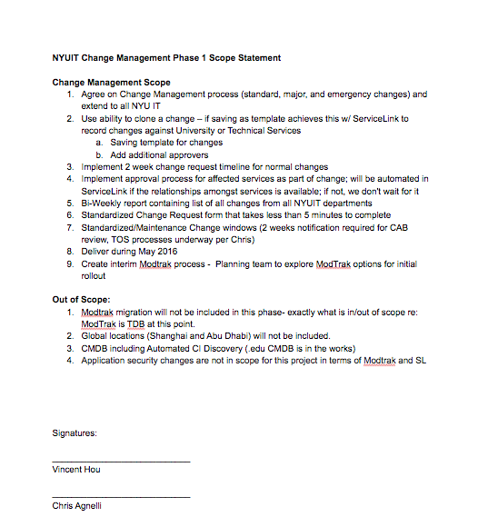
Notes:
Concepting: The process that addresses project objectives by finding the best ways to meet them.
Business and Project Objectives
Context Diagram Reflecting Business Processes Impacted and External Entities (Interfaces)
Project Constraints
Project Assumptions
Critical Success Factors
Proposed Product / Service Statement

Slide 24
Break Time
10 Minutes

Slide 25
Explore
45 Minutes

Slide 26
Gathering high-level needs (concepting)
Problem or need statement
Information gathering
Constraints
Alternative analysis
Project objectives

Slide 27
Set realistic expectations when gathering initial requirements
Notes:
When you first meet with stakeholders, they may get the impression that EVERY suggestion they make will be captured. Ensure that you communicate with them on the process you’ll take to verify the final requirements. Maybe you’ll have an anonymous vote - or maybe the project sponsor has final veto. Making sure everyone knows how their feedback will be considered isn’t just polite - it could save you a lot of rework later in the project when stakeholders find out something they expected wasn’t included.

Slide 28
Project Scope Statement
A scope statement is a document used to develop and confirm a common understanding of what the project will deliver
A scope statement describes in detail the work to be done
It is helpful to create a preliminary scope statement during project initiation so that the entire project team can start important discussions and work related to the project scope
There are usually several versions, and each one becomes more detailed as the project progresses and more information becomes available

Slide 29

Apply the SCOPE STATEMENT throughout the project:
Project Charter
Statement of Work
Change Requests
This Photo by Unknown Author is licensed under CC BY-SA

Slide 30
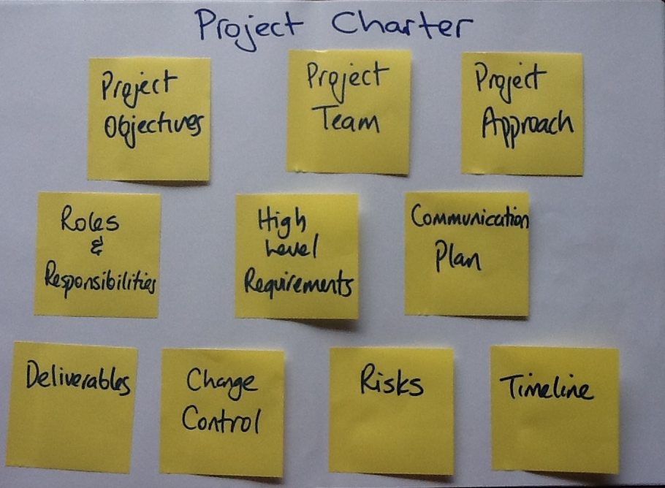
1.
Define the scope in the Project Charter
This Photo by Unknown Author is licensed under CC BY-SA-NC

Slide 31

2.
Specify the needs in the statement of work (SOW) for contracts
This Photo by Unknown Author is licensed under CC BY-SA-NC

Slide 32
Statement of Work (SOW)
A high-level narrative description of products, services, or results to be supplied by the project.
The purpose of the SOW is to give the organization and the project manager guidance on work requirements and end results sought.
SOW means different things to different organizations. At NYU, an SOW is usually provided by an outside vendor who wins a bid. The SOW tells NYU exactly what they’ll do, when, and for how much.

Slide 33
Statement of Work (SOW)
Example SOW 1: SOW Lite
Example SOW 2: SOW Technology Vendor
Tip: Google an SOW for your industry of interest

Slide 34
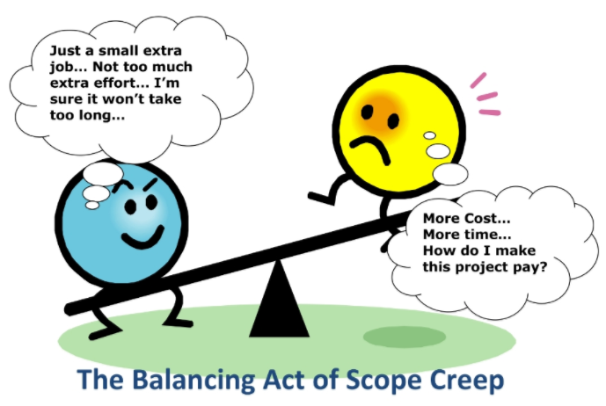
3.
Vet change requests and control scope creep.
Source: http://yourprojectmanager.com.au/managing-project-scope-avoid-scope-creep/

Slide 35
Control Scope
Understand the changes you NEED to make
Keeps everyone clear of the consequences of a change

Slide 36
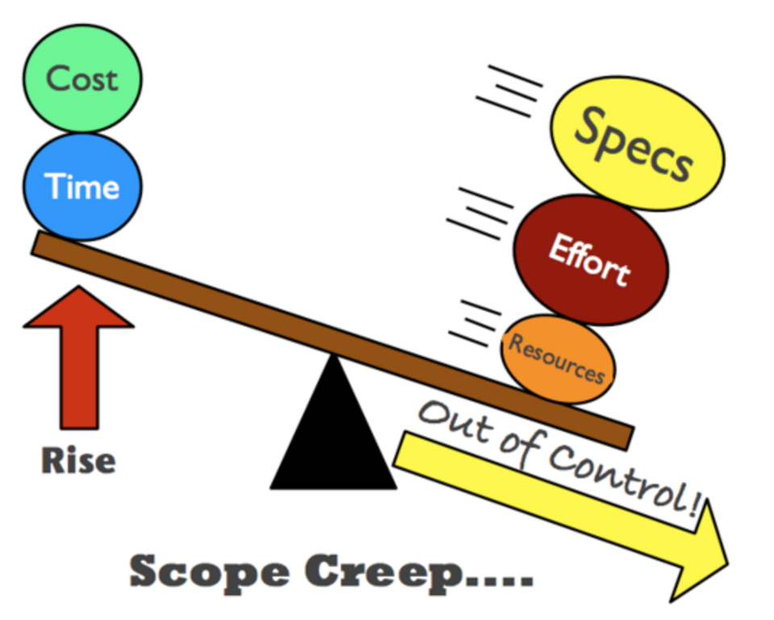
Project Management manages
inputs
and outputs
to avoid scope creep

Slide 37
Control Scope: Changes
Things will likely change!
Basic Change Steps:
  Realize a change is needed
  Create a change request
  Get the change approved
  Do variance analysis
  Replan the work
  Create new baseline

Slide 38
Verify Scope
Is the project ready to go
  The stakeholders decide when the project is done.
Do the deliverables meet the acceptance criteria
  Inspect the deliverables with the stakeholders.

Slide 39
Scope Risks
MSPM1-G2030

Slide 40









Scope Risks
MSPM1-G2030
UNCLEAR
REQUIREMENTS
OPTIMISTIC
APPROACH
IMPROPER
INTERPRETATION
ALLOWING
CONCURRENT
ENGINEERING
INTERNAL
ALLOWING EXTERNAL
CHANGES
CHANGES
PROCESS
NOT USED
NO CHANGE
PROCESS
SCOPE
REDUCTION

Slide 41








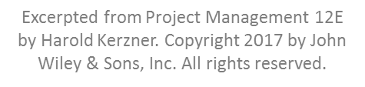
Accepting Unclear Requirements
MSPM1-G2030
Provide statement of work checklists to customers.
Rewrite in your own terminology and get customer approval.
Early on interface meetings with the customer.
UNCLEAR
REQUIREMENTS

Slide 42








Misinterpretation of Requirements
MSPM1-G2030
Request clarification from the customer.
Make effective use of your subject matter experts.
Provide education and training on writing/ interpreting the statement of work.
IMPROPER
INTERPRETATION

Slide 43








Highly Optimistic Technical Approach
MSPM1-G2030
Implement technical risk management.
Understand the customer’s definition of success and your definition of success.
Maintain control over value-added ideas.
OPTIMISTIC
APPROACH

Slide 44








Allowing Your Team to Make Unnecessary Changes
MSPM1-G2030
INTERNAL
CHANGES
Emphasize the customer’s objectives to the team (both technical and business).
Discourage going off on tangents.
Maintain control over value-added ideas.

Slide 45








Allowing Unnecessary Customer-Generated Changes to Occur
MSPM1-G2030
Verify the contract wording concerning scope changes.
Determine the impact on the constraints.
Evaluate the use of some enhancement projects to be accomplished later.
EXTERNAL
CHANGES

Slide 46








Improper Use of Concurrent Engineering
MSPM1-G2030
Explain the risks to the customer with overlapping work.
Be conservative when overlapping activities.
Using committee sponsorship may be necessary.
CONCURRENT
ENGINEERING

Slide 47
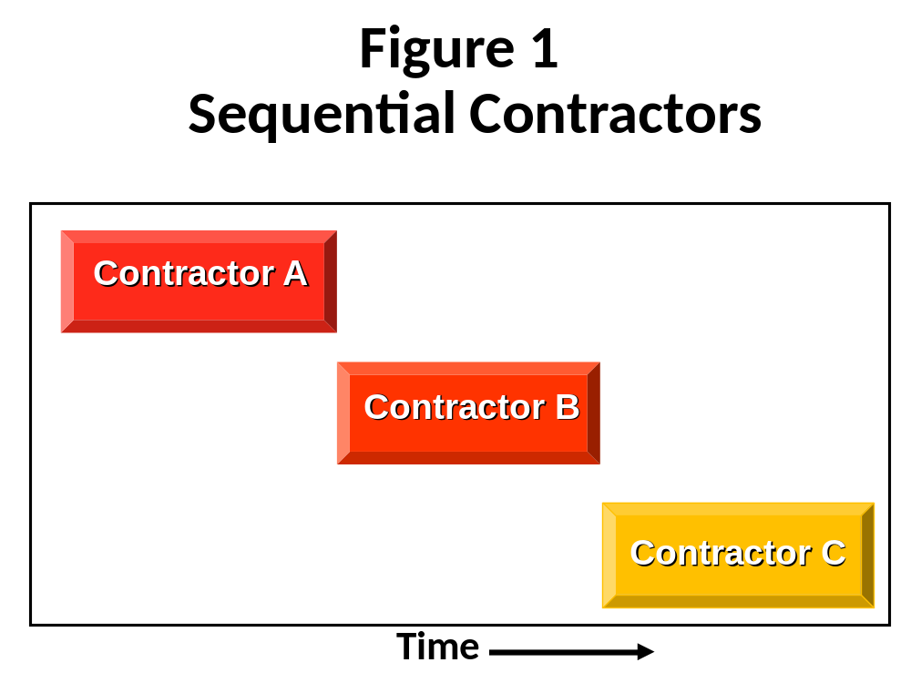
MSPM1-G2030

Slide 48
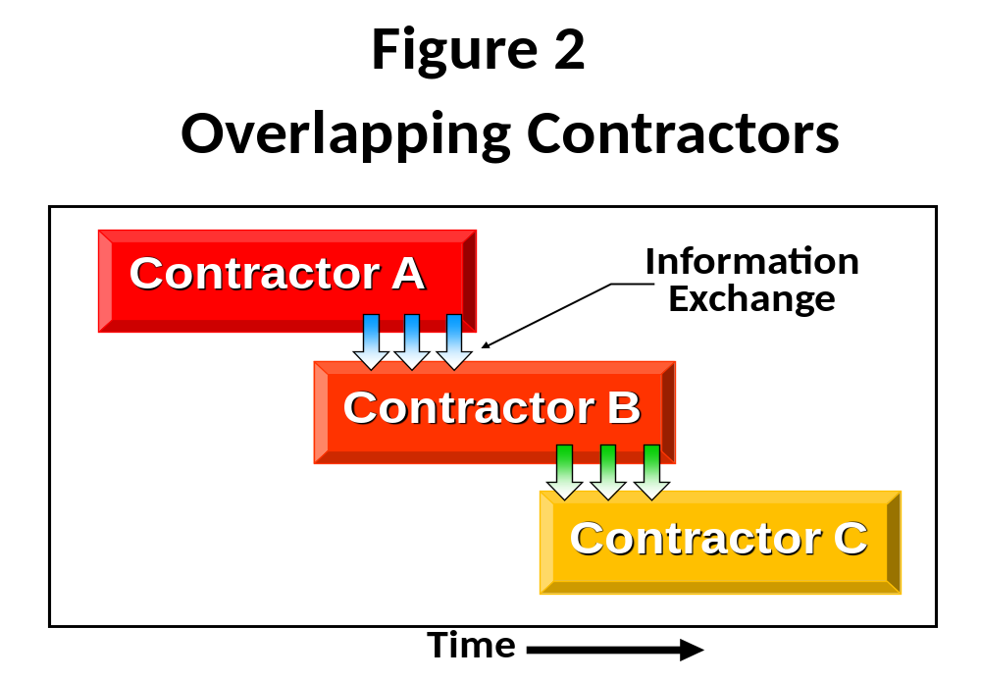
MSPM1-G2030

Slide 49








Having No Change Control Process
MSPM1-G2030
NO CHANGE
PROCESS
Establish a structured configuration management plan.
Explain the plan to the customer.
Make sure that the configuration management plan is part of the contract.

Slide 50








Not Using the Change Control Process
MSPM1-G2030
PROCESS
NOT USED
Force compliance to the change control process.
Identify change control stakeholders and their roles.
Evaluate continuous changes versus using some enhancement.

Slide 51








Avoid Scope Reductions to Lower Cost
MSPM1-G2030
Avoid highly optimistic technical approach.
Avoid highly optimistic scheduling.
Try to avoid cost-scope trade-offs.
SCOPE
REDUCTION

Slide 52
MSPM1-G2030
Cost of Scope Creep
Some of the costs include:
Final cost of the deliverable may make us non-competitive
ROI may occur too late
Insurmountable obstacles and risk make us fail.
Legal and regulatory uncertainties are not studied.
Scope changes must be balanced; limit scope

Slide 53
MSPM1-G2030
Understanding Scope Changes
Regardless of what people think, scope changes, if approved, will result in:
  Elongation of the schedule
  An increase in the cost baseline
  Possibly unhappy stakeholders

Slide 54

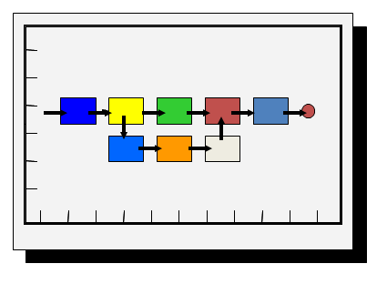
Drivers on Scope
MSPM1-G2030
Improper use of concurrent
engineering
Highly optimistic technical
approach

Slide 55
Characteristics of Success
MSPM1-G2030
  Executive support
  User involvement
  Clear business objectives
  Emotional maturity
  Optimized scope
  Agility
  Project management expertise
  Skilled resources
  Execution
  Tools and infrastructure

Slide 56
Break Time
10 Minutes

Slide 57
Demonstrate
60 Minutes

Slide 58
MSPM1-G2030
  Consumer Markets
  Financial Services
  Government
  Healthcare, Pharmaceuticals & Life Sciences
  Information Technology, Communications & Entertainment
  Industrials
  Non-Profits
Industries

Slide 59
Industries: Segments
  Consumer Markets
    Retail (products, services)
    Food & Beverage
  Financial Services
    Banking
    Construction
    Insurance
    Investments
    Real Estate
  Government
  Healthcare, Pharmaceuticals & Life Sciences
  Information Technology, Communications & Entertainment
  Industrials
    Aerospace & Automotive
    Construction
    Energy & Oil
    Heavy Metals
    Transportation
  Non-Profits, i.e., universities, hospitals, mission-based org.
Note: Accounting, consulting, legal, taxes are secondary services that support industries

Slide 60
Team Exercise
Project Proposal

Slide 61
Case Study: Marriott Bedding Program
As you read the case, think of how you would control scope throughout the project if you were the PM.

Slide 62
MSPM1-G2030
Hotel: In-class exercise (Examples)
Draft a project charter for an alliance with a vendor in another industry
Consumer Markets:
Scope: Increase hotel fitness amenities utilization by 50% by 3/31/2022
Healthcare:
Scope: Increase hotel revenues by 50% by offering medical recovery and rehabilitation tourism by 3/31/2022
Telecommunications:
Scope: Increase bandwidth, speed, charging and uptime by 50% for hotel guests and meeting conferences by 3/31/2022
Financial Services:
Scope: Increase loyalty and revenue by 50% and decrease airline/ hotel overbookings by 50% by 3/31/2022
Note: Accounting, consulting, legal, taxes are secondary services that support industries

Slide 63
Continuous Improvement Project
Managing Project Scope:
Theme: Goals, Objectives, and Deliverables
Write a proposal to address your targeted scope objective. Describe the problem statement, business case, current as-is state and future desired solution to develop and national roll out in the US, and to partner with one (1) other continent for an expanded rollout by a target date one year into the future. (2-page maximum)
Sample sources to imagine your project: U.S . Digital Services:
How we work: https://www.usds.gov/how-we-work U.S. Digital
Playbook: https://playbook.cio.gov/#plays_index_anchor
Or model the Marriott business case with an alliance.
Note: Accounting, consulting, legal, taxes are secondary services that support industries

Slide 64

Requirements Document
A requirements document explains why a product is needed
Describes what the finished product will be like
Is the formal list of requirements

Slide 65
Collecting Requirements
Example of requirements document

Slide 66
Reflect
15 Minutes

Slide 67

Session Recap
End of Deck
MSPM1-G2030
67
This Photo by Unknown Author is licensed under CC BY-SA-NC

